Slide 1
Lesson Plan
1 – (15 Oct) Physical quantities and Vectors
2 – (22 Oct) Kinematics
3 – (29 Oct) Kinematics and Dynamics
4 – (05 Nov) Dynamics
5 – (12 Nov) Work, Energy and Power (WEP)
6 – (19 Nov) WEP & Linear Momentum (LM)
7 – (26 Nov) Revision for MST
(30 Nov) [MST (25 %) likely on Fri evening
8 – (03 Dec) MST week
9 – (10 Dec) Term break
10 – (17 Dec) Term break
11 – (24 Dec) Term break
12 – (31 Dec) LM and Simple Harmonic Motion (SHM)
Practice Skypes with Student
13 – (07 Jan) SHM & Mechanical Waves
14 – (14 Jan) Static Electricity (elearning – skype)
15 – (21 Jan) Static Electricity [contd]
16 – (28 Jan) Magnetism
17 – (04 Feb) Electromagnetism
18 – (11 Feb) Revision for exams

Slide 2
Physical quantities
MS864M

Slide 3
Learning Outcome
Definition of Physical Quantities
SI units – Base and Derived physical quantities
Dimension – Homogeneity vs Physically correct
Accuracy – SF, Dec pl. Rules of operations

Slide 4
Physical quantities
Physics is the most fundamental physical science.
It is the foundation of engineering and technology.
It is based on experimental observations and measurements.
Physical quantities are measurable quantities.
Examples are the weight and height of a person.

Slide 5
Physical quantities
When we measure a physical quantity we are comparing it with a standard.
For example, if the length of a stick is 2.98 m, we mean it is 2.98 times the standard length defined as 1 m.
Physical quantities must be quoted with values and units.
E.g. the mass of a stone is 50.0 kg, the distance is 100 m.
The Systeme International (in French) or SI units is used globally by scientists and engineers.

Slide 6
Advantage of the SI system
Prefixes can be used with any unit, e.g.
1 nanosecond (ns) = 10⁻⁹ s
1 millimetre (mm) = 10⁻³ m
1 kilometre (km) = 10³ m
Very large or very small numbers can be expressed in scientific notations, e.g.
Radius of Earth = 6.4 × 10⁶ m
Radius of hydrogen atom = 1.3 × 10⁻¹⁵ m

Slide 7
Measurement standards
The criteria for measurement standards are :
readily accessible
can be measured reliably
must yield the same results no matter who or where it is measured
must not change with time
Obviously, the length of someone’s foot is not a suitable standard of length!

Slide 8
Standard of time
The SI unit of time is the second.
This is defined as 9,192,631,770 times the period of vibration of the radiation from the cesium-133 atom.
Based on this standard, one day is 8.6 × 10⁴ s.

Slide 9
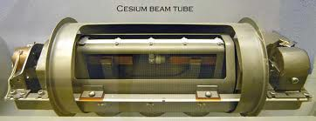

Slide 10
Standard of length
The SI unit of length is the meter.
This is defined as the distance travelled by light in vacuum in 1/299,792,458 s.
This standard was chosen because the speed of light in vacuum is the same everywhere and every time.
Based on this standard, the distance from our Sun to the nearest star, Proxima Centauri, is 4 x 10¹⁶ m.

Slide 11
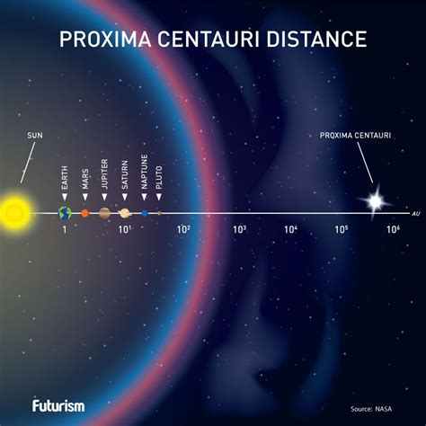

Slide 12
Standard of mass
The SI unit of mass is the kilogram.
This is defined as the mass of a specific platinum-iridium alloy cylinder kept at the international Bureau of Weights and Measures at Sevres, France.
Based on this standard, the mass of an electron is 9.11 x 10⁻³¹ kg.

Slide 13


Slide 14
Base physical quantities
Scientists have decided on seven SI physical base quantities, each with a symbol and base unit.
Base quantity | Base unit | Name of unit
mass | kg | kilogram
length | m | metre
time | s | second
current | A | ampere
temperature | K | Kelvin
amount of substance | mol | mole
luminous intensity | cd | candela

Slide 15
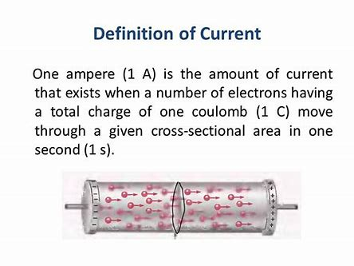

Slide 16
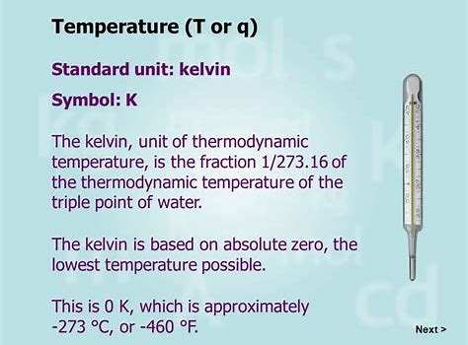

Slide 17
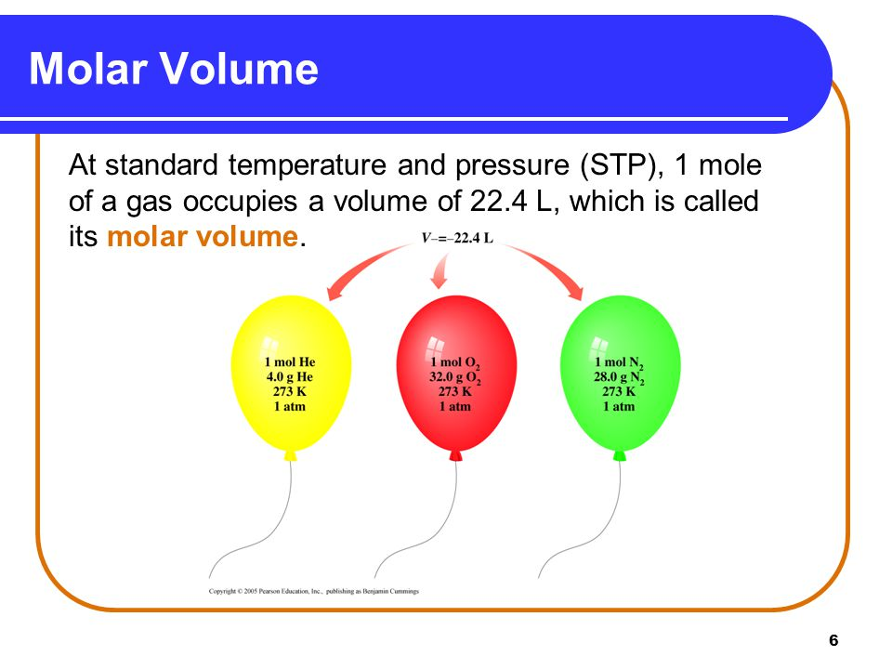

Slide 18
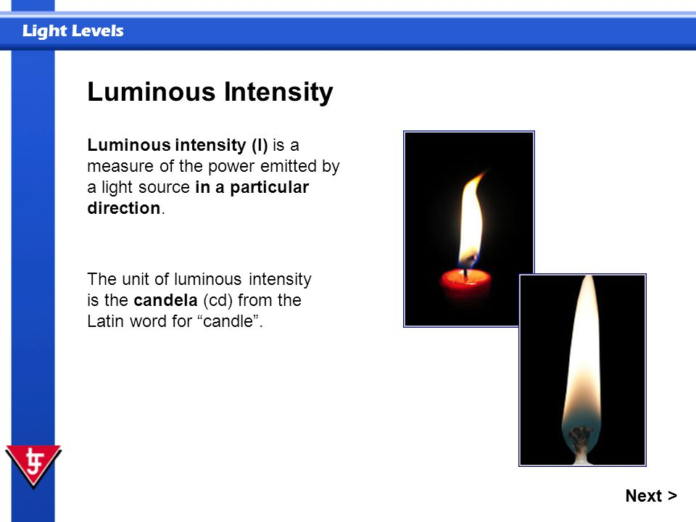

Slide 19
Derived quantities and units
Derived quantities are products or quotients of base quantities, e.g.
Area is length multiply with length.
Speed (distance/time) is length divide with time.
Density (mass/volume) is mass divide with length³.
Derived units are products or quotients of base units.
E.g. of derived units are m², kg/m³, m/s, kg m/s

Slide 20
Special names of derived units
Some derived units have special names.
Special names are in small letters.
Symbols are single capital letter or start with capital letter.
Quantity | SI unit | Special name | Symbol
Force | kg m/s² | Newton | N
Work | kg m²/s² | Joule | J
Pressure | N/m² | pascal | Pa
Power | J/s | Watt | W

Slide 21
Dimensions of base quantities
Each base quantity has an associated dimension.
Dimensions does not depend on the units used.
E.g. the dimension of length is L, whether it is measured in inches or metres.
Base Quantity | Base SI Unit | Dimension
mass | kg | [M]
length | m | [L]
time | s | [T]
current | A | [I]
temperature | K | [θ]
amount of substance | mol | [N]
luminous intensity | cd | [J]

Slide 22
Dimensions of derived quantities
Each derived quantity has dimension which is the product or quotient of base quantities dimensions.
Derived quantity | Derived SI unit | Derived Dimension
volume | m³ | [L]³
velocity | m/s | [L]/[T]
force | kg m/s² | [M][L]/[T]²
work | kg m²/s² | [M][L]²/[T]²
specific heat capacity | m²/s² K | [L]²/[T]²[θ]

Slide 23
Dimensionless quantities
Dimensionless quantities are ratios of quantities with the same dimensions.
Examples are:
relative density
relative atomic mass
efficiency
angle in radians
relative humidity

Slide 24
Uses of dimension analysis
Dimension analysis is used to
check if a relationship or equation is incorrect.
determine the unit of a physical quantity.
predict relationships between physical quantities.

Slide 25
Example 1
If k is dimensionless, m is mass, l is length and T is period, is the equation correct?
The dimension of period T is [T].
The dimension of is
Hence the equation is not homogeneous or dimensionally inconsistent.

Slide 26
Example 2
Prove whether v² - u² = 2as is homogeneous, where u and v are velocities, a is acceleration and s is displacement.
The dimension of v² - u² is
The dimension of 2as is
Both sides have the same dimensions and the equation is homogeneous.

Slide 27
Example 3
Show that k is dimensionless in the equation where F is force, v is velocity, r is radius and ρ is density.

Slide 28
Homogeneity vs physically correct
A homogeneous equation is dimensionally correct.
When an equation is homogeneous, the left hand side and right hand side of the equation have the same dimension.
A dimensionally correct (or consistent) equation may not be physically correct.
For example, v² = u² + as is dimensionally correct but physically wrong because the number 2 is missing.

Slide 29
Special notes
Quantities of different dimensions cannot be added/subtracted.
E.g. it is meaningless to add time and length because these two physical quantities have different dimensions.
Dimensional analysis cannot be used to find missing or unknown dimensionless factors/constants.
In the example on v² = u² + as, the number 2 in front of the term “as” is derived using mathematics on kinematics.

Slide 30
Measurements
Measurement is a process where a physical quantity is compared with a calibration scale.
Measurements always have uncertainties because of
limitations of the person taking the measurement.
the instruments used.
the methods used.

Slide 31
Accuracy and precision
Precision of an instrument refers to the limit of its sensitivity.
E.g.
meter rule : precision is up to 0.1 cm
micrometer screw-gauge : precision is up to 0.001 cm.
Accuracy refers to how close the measured quantity is to the “true” value.

Slide 32
Uncertainty in measurements
Absolute uncertainty of R is ± ΔR, where ΔR is usually half of the smallest scale division.
Fractional uncertainty of R is
Percentage uncertainty of R is
We should always measure small quantities with high precision.

Slide 33
Scale reading
A scale reading is a measurement read directly from the scale markings of an instrument.
The number of significant figures you quote in measurement indicates the precision of the measurement.
In the example below, the digit 5 is uncertain because the actual answer could be anything between 24 cm and 25 cm.
Scale reading = 24.5 cm (3 s.f.)
0
10
20
30

Slide 34
Significant figures (s.f.)
The uncertainty of a measurement is indicated by its number significant figures.
E.g. if the thickness of a book is 2.91 mm, it is precise to three significant figures.
The first two digits are correct while the third digit has an uncertainty of about 0.01 mm.
The result of calculations must be written with an appropriate number of significant figures.
E.g. 2.0 × 11.0 = 22 (2 s.f.) and not 22.0 (3 s.f)

Slide 35
Identifying significant figures
In whole numbers with trailing zeroes, the zeroes may or may not be significant.
The number 500 may have 1, 2 or 3 significant figures depending on the context
In such cases, use the scientific notations.
500 written as 5 x 10² implies 1 s.f.
500 written as 5.0 x 10² implies 2 s.f.
500 written as 5.00 x 10² implies 3 s.f.

Slide 36
Identifying significant figures
Zeroes before first non zero digit are not significant.
0.0023 has 2 s.f.
Zeroes within numbers are significant.
0.0203 has 3 s.f.
Zeroes after the decimal point are significant.
2705.40 has 6 s.f.
1.00 has 3 s.f.

Slide 37
Significant figures in answers
The answer obtained from mathematical operations on numbers cannot be more precise than the numbers used in the operation.
There are rules on the number of s.f. in the answer arising from
multiplication
division
addition
subtraction

Slide 38
Rules on multiplication
The number of significant figures in the answer follows the quantity with the least significant figures.
E.g. 2.4 2 s.f
× 3.65 3 s.f
= 8.76 3 s.f = 8.8 2 s.f.

Slide 39
Rules on division
The number of significant figures in the answer follows the quantity with the least significant figures.
E.g. 725.0 4 s.f.
0.125 3 s.f.
= 5800 = 5.80 × 10³ to 3 s.f.

Slide 40
Rules on addition
The answer has the same number of decimal places as the quantity with the least number of decimal places.
E.g. 23.1 3 s.f and 1 d.p.
+ 0.546 3 s.f. and 3 d.p.
+ 1.45 3 s.f. and 2 d.p.
= 25.096
= 25.1 3 s.f and 1 d.p.

Slide 41
Rules on subtraction
The final result has the same number of decimal places as the quantity with the least number of decimal places.
E.g. 1.002 4 s.f. and 3 d.p
– 0.998 3 s.f. and 3 d.p
= 0.004 1 s.f and 3 d.p
This example shows we should never subtract two quantities which differ by a small amount.

Slide 42
Summary
Definition of Physical Quantities
SI units – Base and Derived physical quantities
Dimension – Homogeneity vs Physically correct
Accuracy – SF, Dec pl. Rules of operations

Slide 43
End of chapter

